Slide 1
A murine model of glucocorticoid myopathy alleviation using androgen therapy
Nicolae Lucian Sandor
July 13th, 2015

Slide 2
Outline
Medical premises
In vivo model
macroscopic
metabolic
molecular
In vitro model
histological
metabolic
molecular
Discussion

Slide 3
Glucocorticoids in humans
Stress hormones working towards hyperglycemia
Activate immunosuppressive mechanisms, such as macrophage apoptosis.
Prescribed to ~1% per annum.
Effects include
edema*
osteopenia
insulin resistance
muscle loss.

Slide 4
Glucocorticoid myopathy
“Proximal weakness”
Myofiber condition
Loss of volume, mass, force
Increased catabolism:
urinary nitrogen
methylhistidine
Some translation component

Slide 5
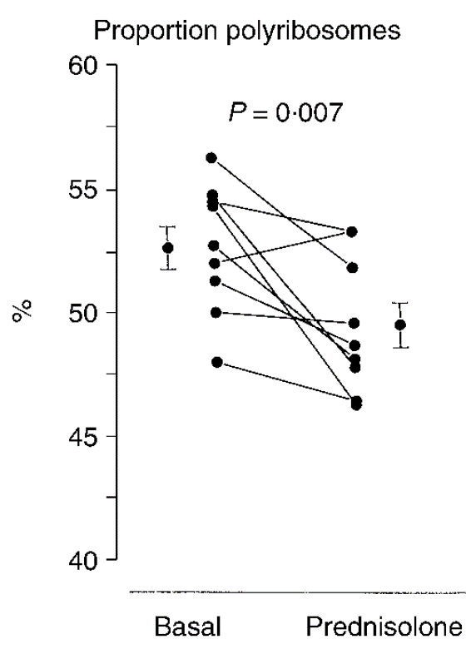
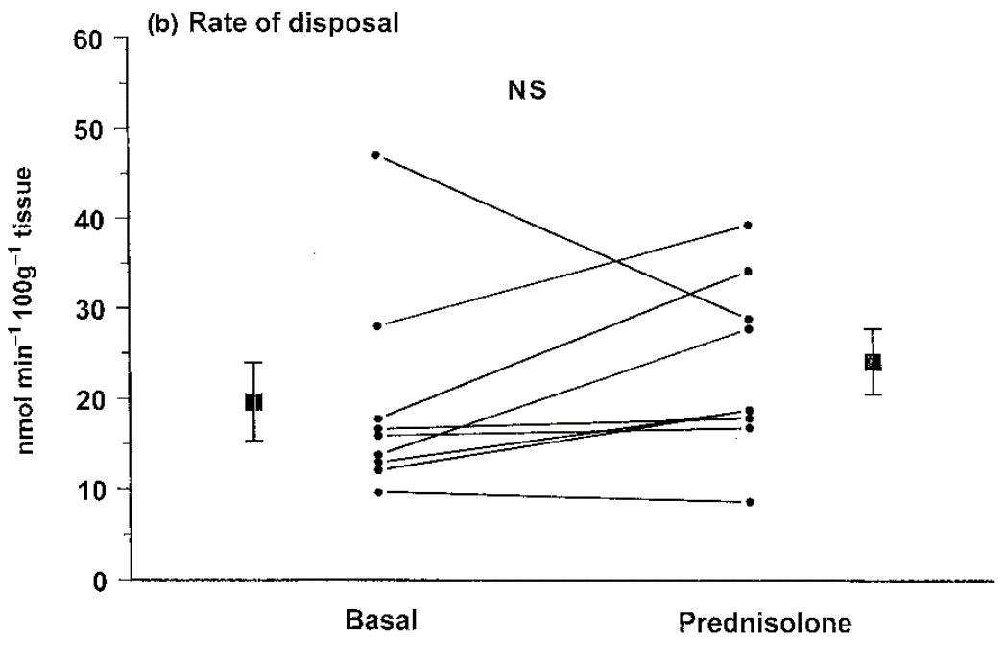
Glucocorticoids effect on translation is understudied
Three-day prednisone on healthy volunteers (Lofberg et al., Eur J Clin Invest, 2002)

Slide 6
Therapeutic approaches to GM
Cessation or surgery, if possible.
Inhibitors of synthesis.
Receptor blockers.
Anabolic adjuvants.

Slide 7
Why testosterone?
Testosterone is effective in sarcopenia of aging, HIV+.
Males with hypercortisolism have lower testosterone.
Testosterone was part of standard of care.
Crawford et al. (2003) showed Testo addition to chronic GC causes:
higher bone density
improved muscle mass and strength
better quality of life.

Slide 8
Why not testosterone?
Females with hypercortisolism have hirsutism.
Males receiving testosterone supplementation might be at higher risk for heart disease, prostate cancer etc.
“Safer” alternatives are desirable.

Slide 9
How is testosterone working?
Androgenic - anabolic - ergogenic hypothesis
Higher amino acid uptake in muscle
Some anti-catabolic component
Stimulates intramuscular IGF-I expression.

Slide 10
Animal models
Glucocorticoids stimulate some fat deposits, confounding arm diameter measurements.
Horses get hyperglycemia.
Dogs get increased urinary nitrogen.
Rats are a good model and have been well-studied.
Mice are less studied.

Slide 11
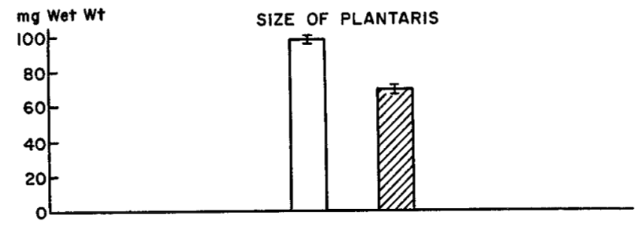
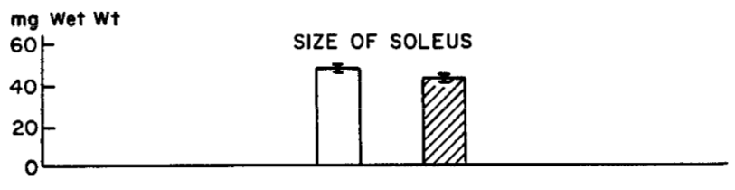
Rats respond to glucocorticoids
Hatched bars represent seven-day 10 mg/kg cortisone on adult male rats (Goldberg, JBC, 1969).
Pair-feeding does not change findings.

Slide 12
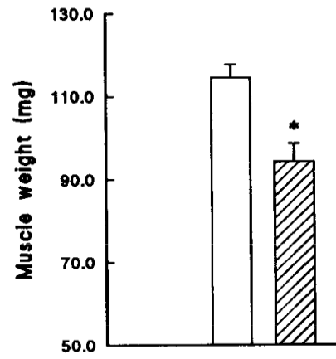
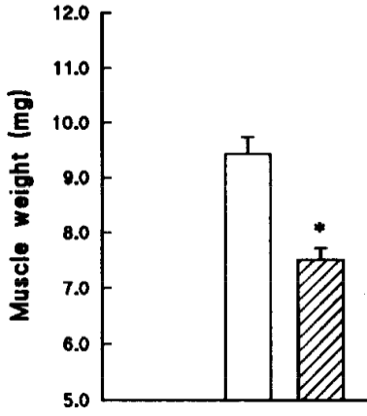
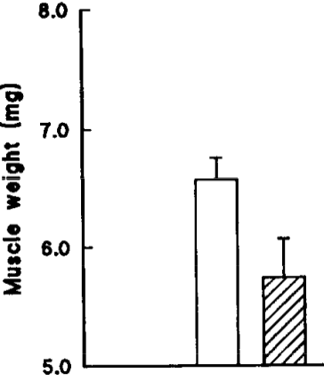
Mice respond to glucocorticoids
Gastrocnemius
Extensor digitorum
Soleus
Hatched bars for ten-day 5 mg/kg dexamethasone on male mice
(Agbenyega et al., Comp Physiol, 1992).

Slide 13
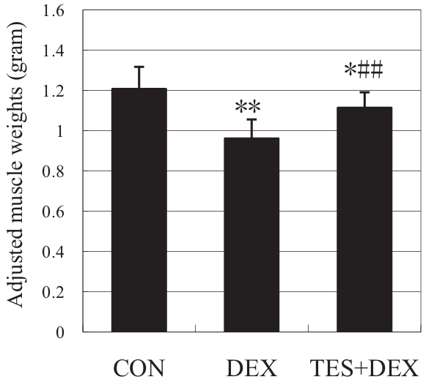
Rat muscles are protected by testosterone co-administration
Gastrocnemius. Ten-day dexamethasone
± 5 mg/kg testosterone (Yin, J Trauma, 2009).

Slide 14
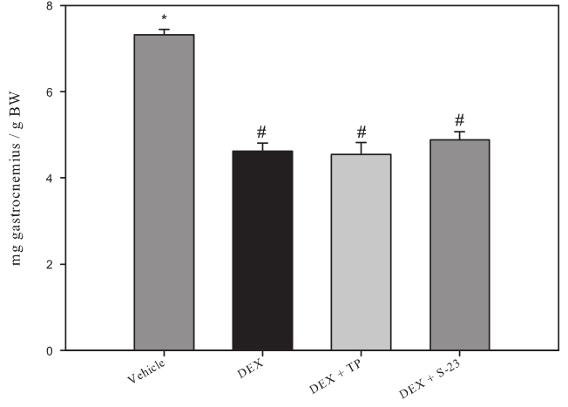
Rat muscles are protected by testosterone co-administration
... Or are they?
Gastrocnemius. Ten-day dexamethasone
± 5 mg/kg testosterone (Yin, J Trauma, 2009).
Gastrocnemius. Eight-day dexamethasone
± 25 mg/kg testosterone (Jones, Endocrinology, 2010).

Slide 15
First hypothesis
Testosterone alleviates dexamethasone-induced muscle atrophy in mice.

Slide 16

In vivo test
± 10 mg / kg D, ± 28 mg / kg T
Tissue collection
V
D
Time (days)
D+T
Eight week old, male, C57BL/6.

Slide 17
Progressive loss of body weight is alleviated by testosterone
body weight
(% gain)

Slide 18
In vivo test
V
Tissue collection
D
Time (days)
D+T
V
Tissue collection
D
Time (days)
D+T
V
Tissue collection
D
Time (days)
D+T

Slide 19
Net effects on body weight at later stage
body weight
(% gain)

Slide 20
Testosterone partly restores lean mass
fat mass
gain (g)
lean mass
loss (g)
Only dexamethasone alters fat deposits.

Slide 21
Testosterone partly restores individual muscles
gastrocnemius (g)
triceps br. (g)
quadriceps (g)
levator ani (g)
one day
three days
seven days
one day
three days
seven days

Slide 22
Conclusion so far
Testosterone reduces dexamethasone-induced reduction in mouse muscle mass.

Slide 23
Metabolic mechanisms of Dexa
Increase in urinary 3MH demonstrates dexamethasone’s pro-catabolic action.
Proteasome is dexamethasone’s main effector:
E3 ligases upregulated
amino acid release decreases by 80% when treated with MG132.
Other proteolytic mechanisms are involved.

Slide 24
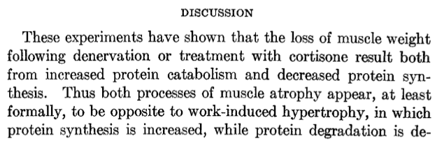
Protein synthesis and Dexa
(Goldberg, JBC, 1969).

Slide 25
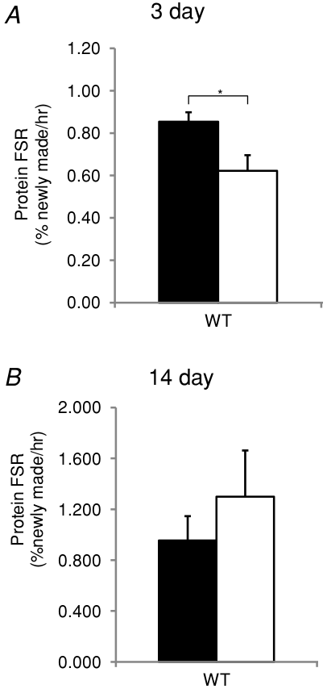
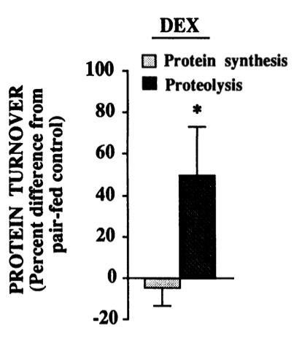
Protein synthesis and Dexa: caveats
Four days, 0.5 mg/kg dexamethasone on male rats
(Dardevet et al., JCI, 1995).
3 mg/kg dexamethasone on male mice
(Baehr et al., J Physiol, 2012).
More caveats later.

Slide 26
Testosterone effect on atrophying muscle
Molecular marker studies in glucocorticoid atrophy, denervation indicate anabolic and anti-catabolic effects.
Anti-proteolytic in rescue of castration (Serra, Sandor et al., 2012).

Slide 27
Second hypothesis
Testosterone’s myoprotective action in the context of dexamethasone atrophy is based on inhibiting the latter’s proteolytic effects.

Slide 28
MuRF1 is restored to baseline levels by testosterone co-administration
gastrocnemius MuRF1 mRNA
quadriceps MuRF1 mRNA
gastrocnemius MAFbx mRNA
quadriceps MAFbx mRNA
one day
three days
seven days

Slide 29
Chymotrypsin-like activity correlates with phenotype
quadriceps proteasome catalytic activity (rel.u.)
Could not substantiate ubiquitination of myosin.
triceps proteasome catalytic activity (rel.u.)
three days

Slide 30
Dexamethasone represses autophagosome-associated genes
gastrocnemius beclin mRNA
gastrocnemius cathepsin L mRNA
gastrocnemius LC3 mRNA
one day
three days
seven days

Slide 31
Cathepsin L activity does not correlate with phenotype
gastrocnemius autophagosome catalytic activity (rel.u.)
quadriceps autophagosome catalytic activity (rel.u.)
triceps autophagosome catalytic activity (rel.u.)
one day
three days
seven days

Slide 32
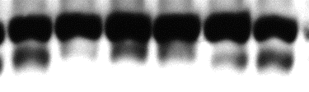

Prenylated LC3 isoform indicates autophagy unchanged
slow >
LC3
fast >
GAPDH
Dexa | - | - | + | + | + | +
Testo | - | - | - | - | + | +
LC3-II normalized to GAPDH
LC3-II normalized to LC3-I
Gastrocnemius, 7 day.
Sub-optimal normalization has been used by others to hypothesize role of autophagy.

Slide 33
Calpain markers did not correlate with the phenotype
gastrocnemius calpain catalytic activity (rel.u.)
one day
three days
seven days
Also, no change in mu-calpain, calpastatin protein levels.

Slide 34
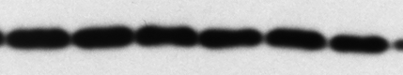
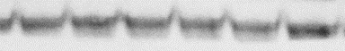

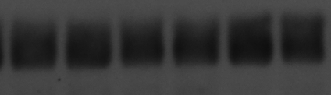
Translation regulators appear unchanged
Ⓟ-eIF2α
eIF3f
GAPDH
GAPDH
Dexa | — | — | + | + | + | +
Testo | — | — | — | — | + | +
Dexa | — | — | + | + | + | +
Testo | — | — | — | — | + | +
Ⓟ-eIF2α
eIF3-f
gastrocnemius, day 7

Slide 35
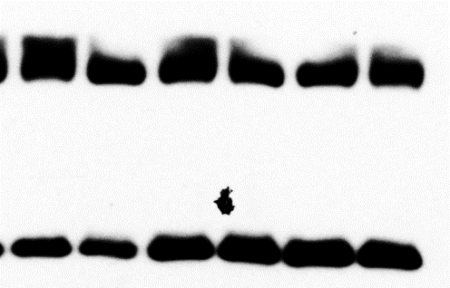
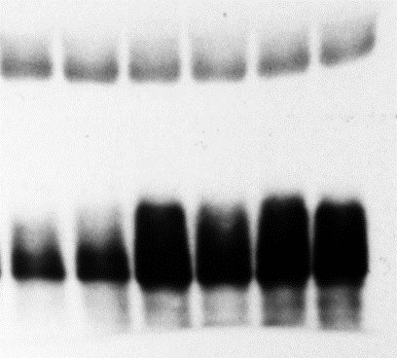
4E-BP is not inhibited by testosterone
GAPDH
GAPDH
Ⓟ-4EBP
total 4EBP
Dexa | — | — | + | + | + | +
Testo | — | — | — | — | + | +
Dexa | — | — | + | + | + | +
Testo | — | — | — | — | + | +
total 4EBP
Ⓟ-4EBP
gastrocnemius, day 7
Could not employ polysome profiling.

Slide 36
Conclusions so far
Dexamethasone-induced loss of muscle is correlated with an increase in proteasome activity and E3 ligases expression.
Rescue by testosterone co-administration is correlated with proteasome repression.
Autophagy, calpains, protein synthesis changes are less correlated with the phenotype.

Slide 37
Transcriptional effects of Dexa
Myostatin
Klf15
GR
MuRF1
muscle
loss
Dexa
Foxo
4EBP

Slide 38
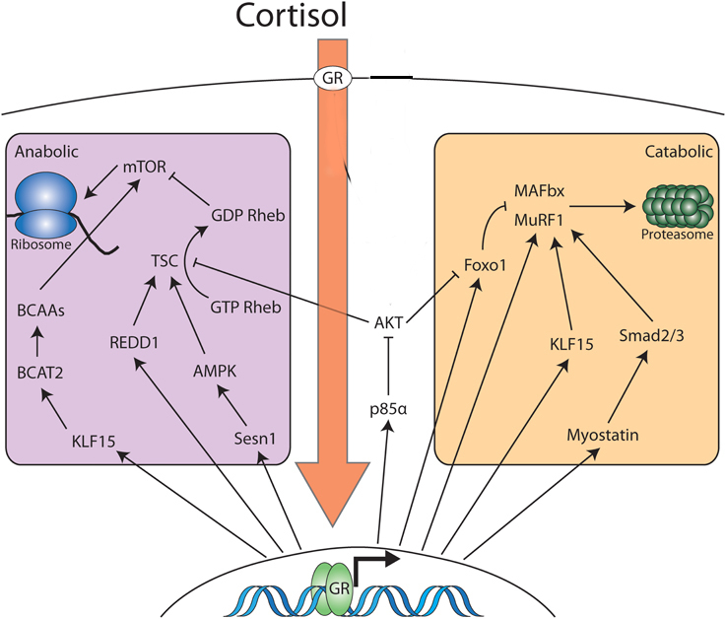
More transcriptional effects of Dexa
Modified from Braun and Jones, Front Physiol, 2015.

Slide 39
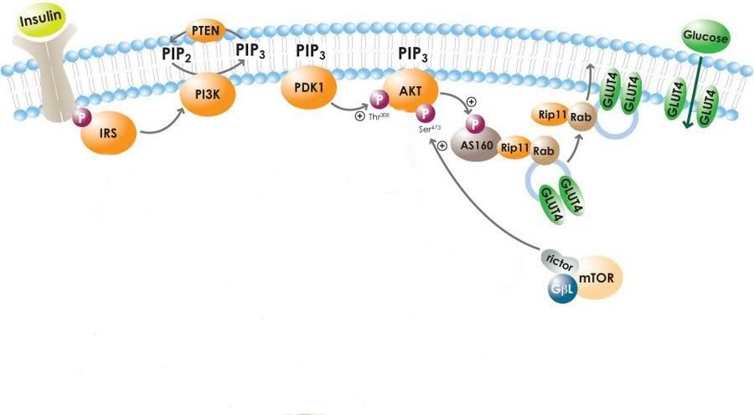
Insulin signaling
May, 2010
Glucocorticoids increase glucose, insulin, but lower glucose uptake.
Putative points of inhibition include IRS 1 and PI3K.

Slide 40
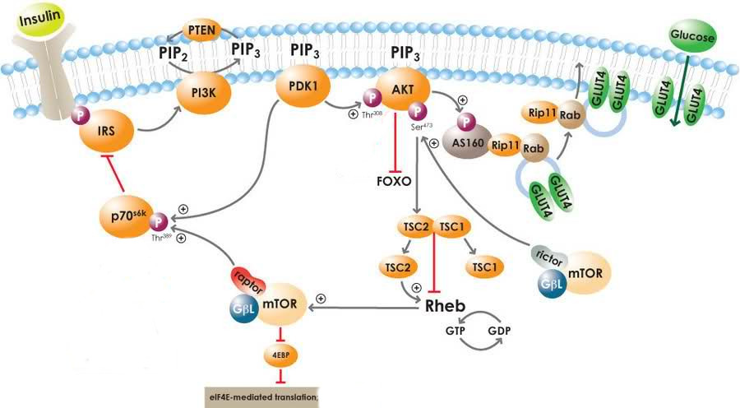
Mechanisms of Akt desensitization

Slide 41
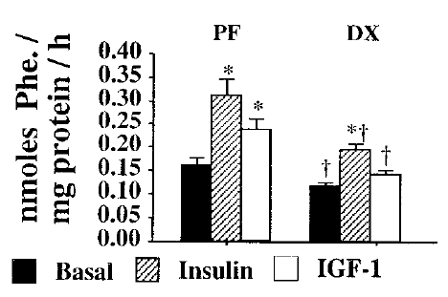
Insulin and IGF-I are equally affected
Dardevet et al., J Endocr, 1998.

Slide 42
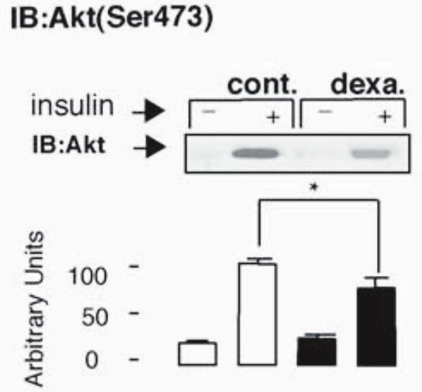
Conditions change results
Rojas et al., Endocrin, 2003.

Slide 43
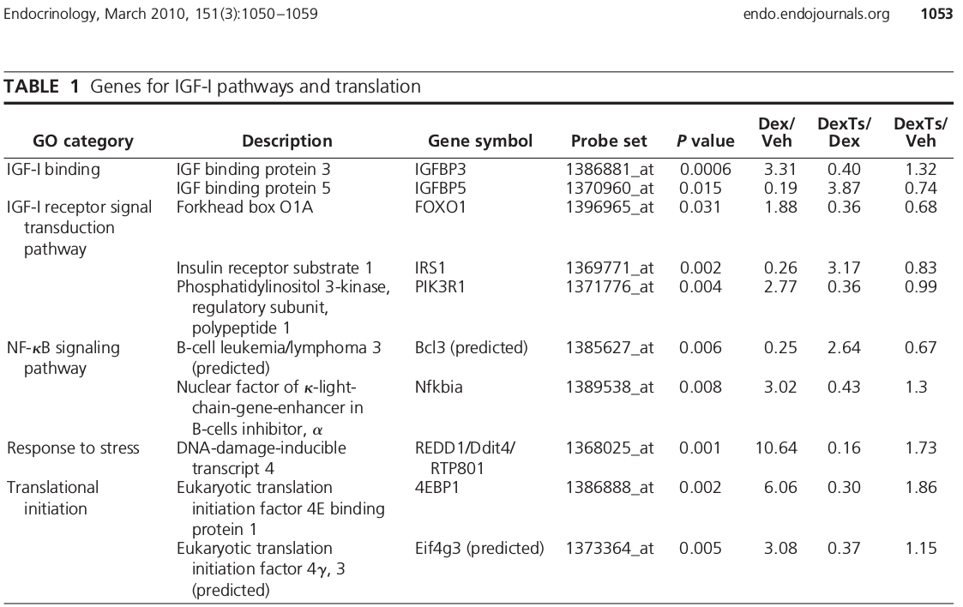
Testosterone mechanisms
Wu et al., Endocrinology, 2010.

Slide 44
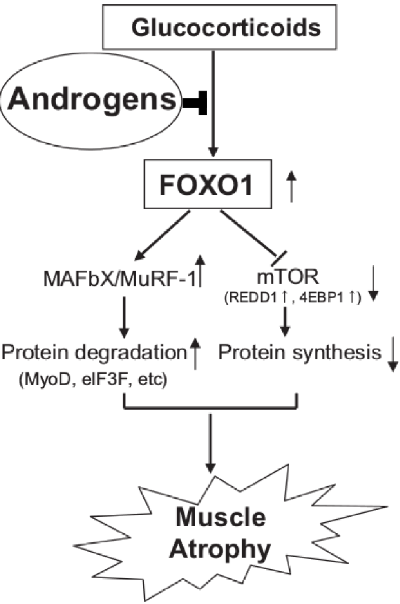
Testosterone mechanisms
Qin et al., BBRC, 2010.
Wu et al., Endocrinology, 2010.

Slide 45
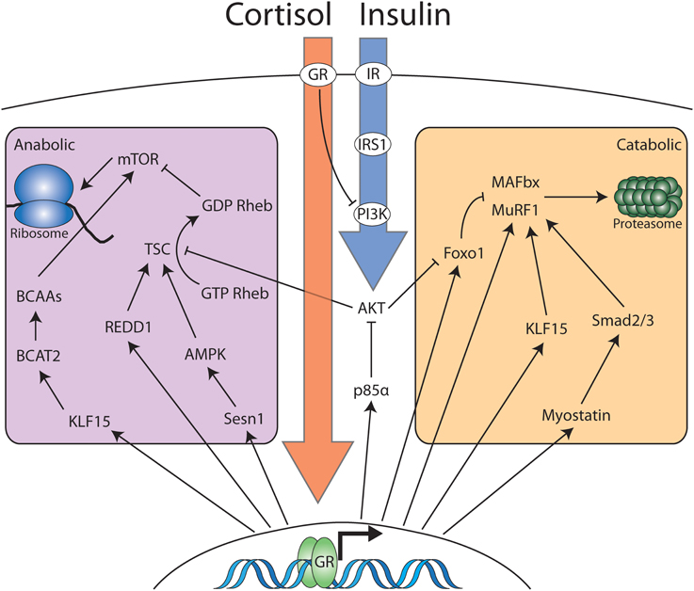
Insulin / IGF-I are upstream of Foxo
Braun and Jones, Front Physiol, 2015.

Slide 46
Third hypothesis
Testosterone’s myoprotective action in glucocorticoid-induced loss of muscle mass is facilitated by a restoration of IGF-I / Akt / Foxo signaling.

Slide 47
Testosterone represses the transcriptional atrophy mediators
quadriceps Foxo3a mRNA
quadriceps Klf15 mRNA
one day
three days
seven days

Slide 48
IGF-I is restored by testosterone co-administration
quadriceps
IGF-I Ea mRNA
one day
three days
seven days

Slide 49
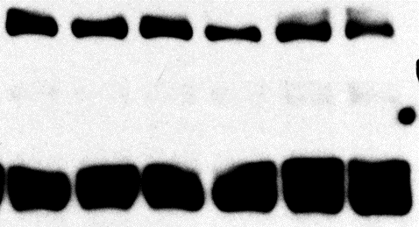
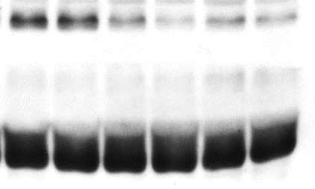
Akt (Ser 473) does not respond to testosterone
total Akt
Ⓟ473-Akt
GAPDH
GAPDH
Dexa | — | — | + | + | + | +
Testo | — | — | — | — | + | +
Dexa | — | — | + | + | + | +
Testo | — | — | — | — | + | +
total Akt
Ⓟ473-Akt
Ⓟ473-Akt /
total Akt
Gastrocnemius, 7 day.

Slide 50
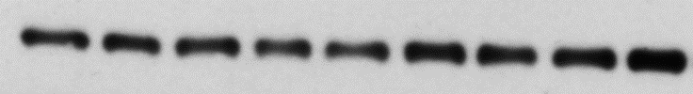
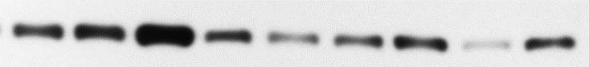
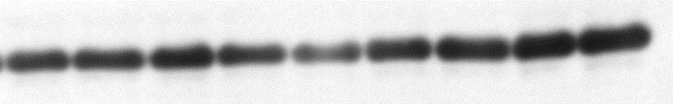
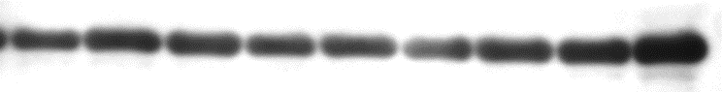
Akt (Ser 473) does not respond to testosterone in hypersensitive levator
total Akt
Ⓟ473-Akt
GAPDH
GAPDH
Dexa | — | — | — | + | + | + | + | + | +
Testo | — | — | — | — | — | — | + | + | +
Dexa | — | — | — | + | + | + | + | + | +
Testo | — | — | — | — | — | — | + | + | +
total Akt
Ⓟ473-Akt
Ⓟ473-Akt /
total Akt

Slide 51
Conclusions so far
Testosterone’s protective action is associated with restoration of basal IGF-I and Foxo signals.
Basal state repression of Akt by dexamethasone appears unchanged by testosterone co-administration.

Slide 52
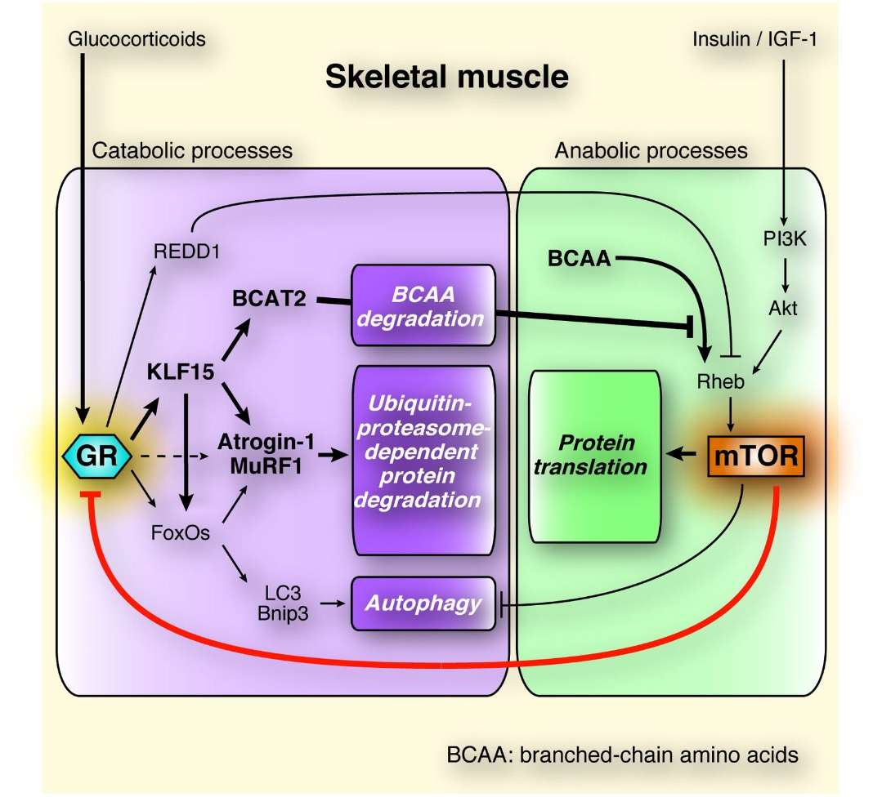
REDD1 to the rescue
Tanaka et al., Cell Metab, 2012.

Slide 53
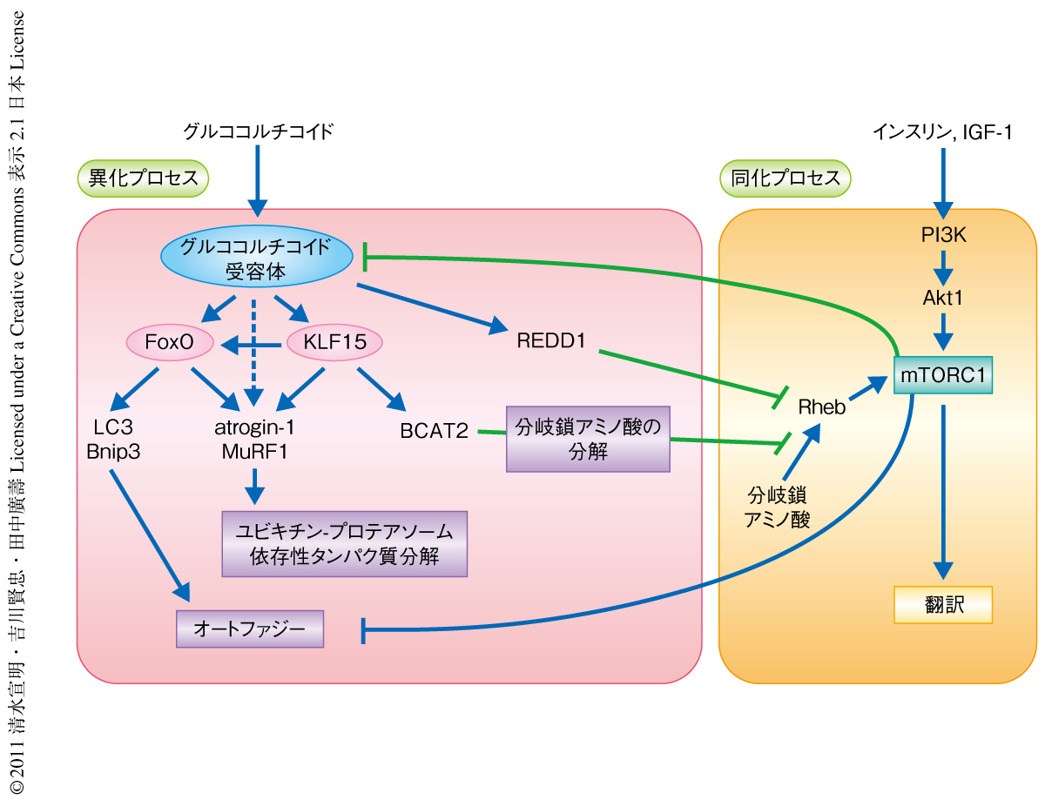
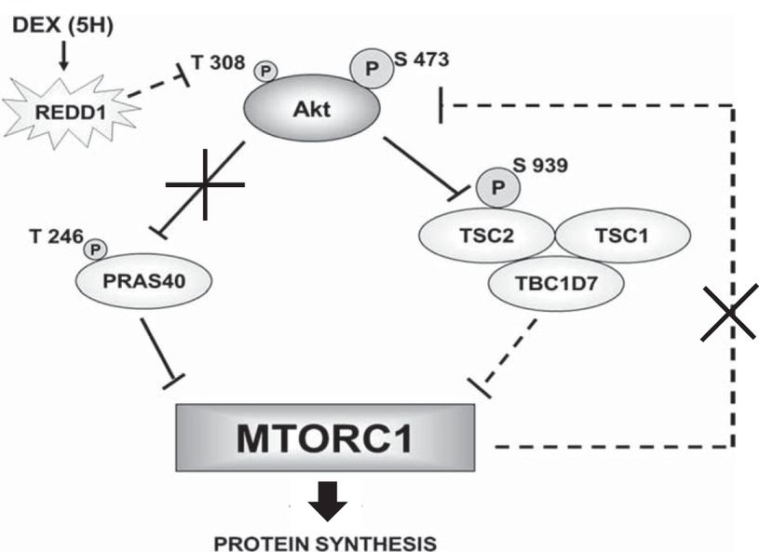
REDD1 to the rescue
Tanaka et al., Cell Metab, 2012.
Britto et al., Am J Physiol, 2014.

Slide 54
REDD1
gastrocnemius
REDD1 mRNA
quadriceps
REDD1 mRNA
one day
three days
seven days

Slide 55
Hypotheses
Testosterone alleviates dexamethasone-induced muscle atrophy in mice.
Testosterone’s myoprotective action in the context of dexamethasone atrophy is based on inhibiting the latter’s proteolytic effects.
Testosterone’s myoprotective action in glucocorticoid-induced loss of muscle mass is facilitated by a restoration of IGF-I / Akt / Foxo signaling.
√
√
…

Slide 56
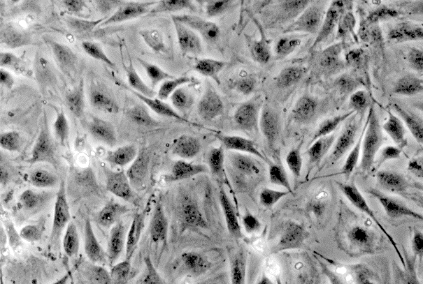
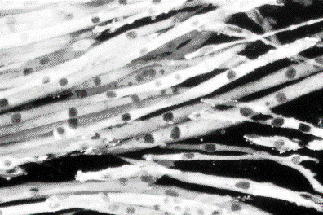
In vitro model
Start differentiation
Serum-free medium
Time
(days)
Undifferentiated
Differentiated

Slide 57
In vitro model
Rat cell studies document dexamethasone-induced proteolysis, Foxo induction etc.
Mouse cell studies are scarce.
Testosterone + Glucocorticoid on rodent cells is not published.
Many of these cell lines thrive with Dexa.

Slide 58


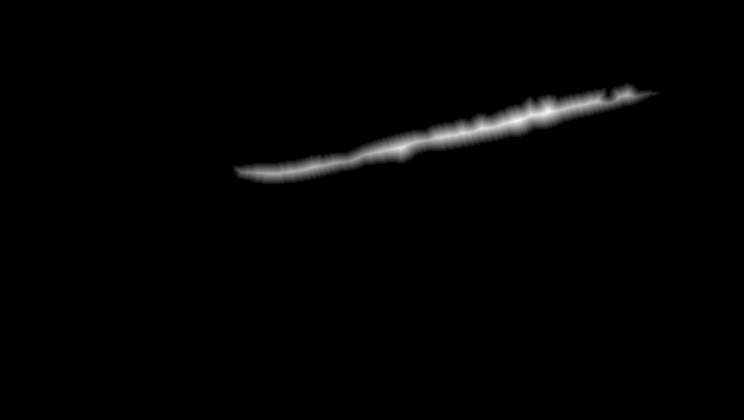
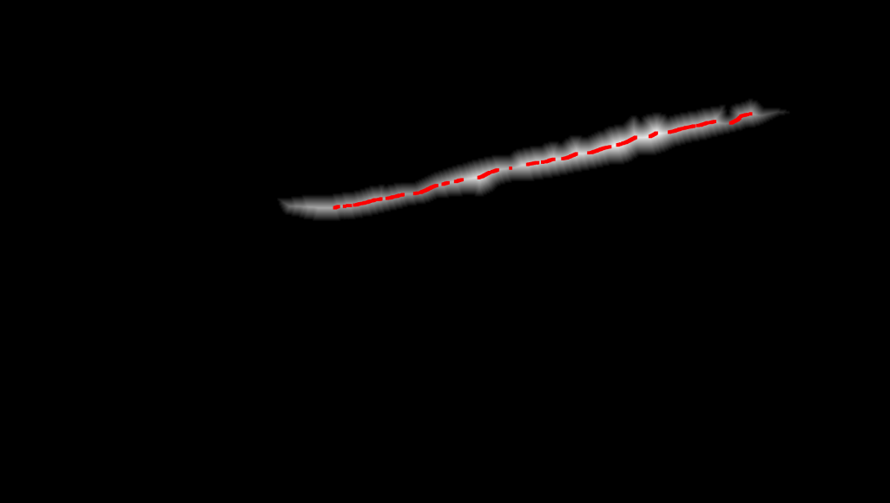
In vitro model
(B) Matlab
(A) Photoshop

Slide 59
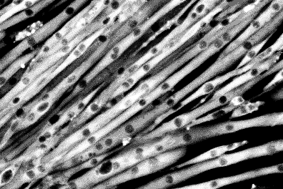
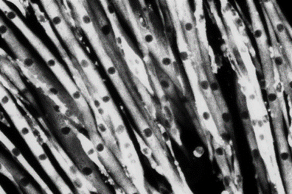
In vitro model
Start differentiation
Start pharmacological treatments
Diff. M.
±T±D
Time
(days)
Vehicle
Differentiated
average cell diameter (rel. u.)
50 µM Dexa
Dexa +
300 nM Testo

Slide 60
More in vitro evidence
Start differentiation
Start pharmacological treatments
1 d
Diff. M.
±T±D
Time
(days)
2 d
Diff. M.
±T±D
total protein (normalized to first day)
At 48 hour, statistically significant difference between Dexa and Veh.
At 48 hour, statistically significant difference between Dexa and Dexa + Testo.

Slide 61
First hypothesis
Testosterone alleviates dexamethasone-induced muscle atrophy in mice.

Slide 62
Protein synthesis in vitro
Start differentiation
Start pharmacological treatments
Diff. M.
0 d
±T±D
Time
(days)
³H-Phe
Diff. M.
1 d
±T±D
³H-Phe
Diff. M.
2 d
±T±D
³H-Phe
Diff. M.
3 d
±T±D
³H-Phe
Preliminary studies showed lack of sensitivity for 4h and 30h.

Slide 63
Protein synthesis in vitro
tracer enrichment
in cell protein
(fmol/g)
At 72 hour, statistically significant difference between Dexa and Veh.
At 72 hour, statistically significant difference between Dexa and Dexa + Testo.
Contradict phenotype in direction, timing.

Slide 64
Protein degradation in vitro
Start differentiation
Start pharmacological treatments
Diff. M.
Time
(days)
0 d
±T±D
³H-Phe
Diff. M.
1 d
±T±D
³H-Phe
Diff. M.
2 d
±T±D
³H-Phe
Diff. M.
3 d
±T±D
³H-Phe
Preliminary studies showed very low tracer uptake past 48 hour.

Slide 65
Protein degradation in vitro
medium to cell protein tracer ratio
At 24 hour, statistically significant difference between Dexa and Veh.
At 24 hour, statistically significant difference between Dexa and Dexa + 500 nM Testo.
Correlate with phenotype in direction, timing.

Slide 66
Second hypothesis
Testosterone’s myoprotective action in the context of dexamethasone atrophy is based on inhibiting the latter’s proteolytic effects.

Slide 67
Inhibitor tests in vitro
Protein
labeling
Start steroid
treatments
Start
differentiation
Diff. M.
Time (days)
±T±D
³H-Phe
Collection of measured medium

Slide 68
Inhibitor tests in vitro
medium to cell protein tracer ratio
Strongest inhibition of proteolysis with proteasome inhibitor MG132..
Non-negligible effect of lysosome inhibitor chloroquine.
Repression to basal level with T co-administration.
IGF1R inhibitor did not alter T effect.

Slide 69
Conclusion
Glucocorticoids
Anabolic steroids
REDD1
IGF-I
Akt
Foxo
MuRF1
proteasome / ubiquitin - mediated catabolism

Slide 70
Future directions
More sensitive assays for Akt.
Better models of IGF-I inhibition.
Mechanistic studies of REDD1 in T co-administration.
More sensitive measurements of protein synthesis.
More mechanistic studies of autophagy.

Slide 71
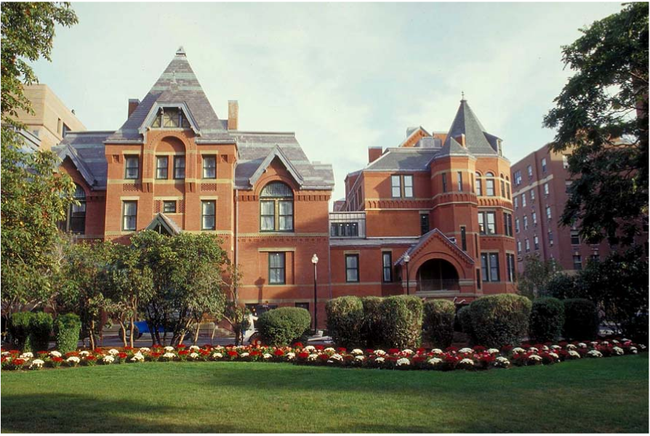
Acknowledgements

